Slide 1
Exchange Rates regimes
Fixed
Floating (Flexible)

Slide 2
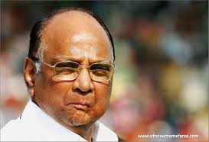



Fixed Exchange Rate Regime (Upto March 1992)
MSP 1400 per Qt.

Slide 3



Fixed Exchange Rate Regime (Upto March 1992)
If not available, then come to me
1$
=Rs.10
Authorized dealers under FEMA

Slide 4
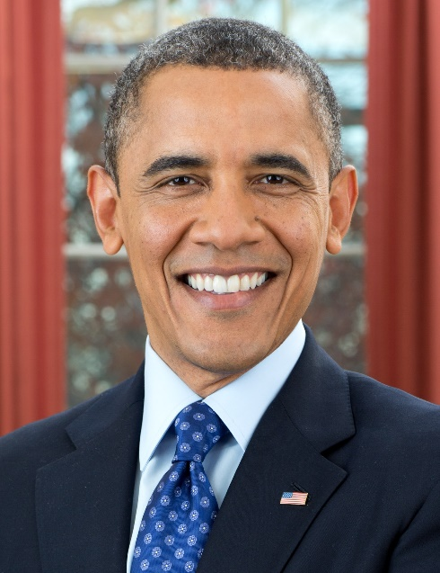
External shock factors
Fixed Exchg.
Martin Luther King Jr. PTC Karlo Yojana
Any person eligible to join PTC (primary teachers course) with $1 lakh fees.
Assured Government teacher job with fixed salary of $2,500

Slide 5
Fixed Exchange Rate Regime (Upto March 1992)
1$
=Rs.10
12, 15, 20, 25

Slide 6

Fixed Exchange Rate Regime (Upto March 1992)
1$
=Rs.10
$1
=15 Rs.
Authorized dealers under FEMA

Slide 7
Devaluation: Fixed Exchange Rate Regime (Upto March 1992)
1$=Rs.11
(10% Devaluation )
Authorized dealers under FEMA

Slide 8


Devaluation: Fixed Exchange Rate Regime (Upto March 1992)
1$=Rs.11
(10% Devaluation )
Devaluation increases
EXPORTS
Authorized dealers under FEMA

Slide 9
Mock MCQ 1999
A: Devaluation of the currency may promote exports
R: Price of the country's product in international market falls due to devaluation

Slide 10

$1 = Rs.10
$1 = Rs.11 (Dvl.)
1 Thumps up MRP Rs.10
= $1
1 Thumps up MRP Rs.10
= $ 10/11
= $ 0.91

Slide 11
Mock MCQ 1999
A: Devaluation of the currency may promote exports
R: Price of the country's product in international market falls due to devaluation
Both right, R explains A

Slide 12
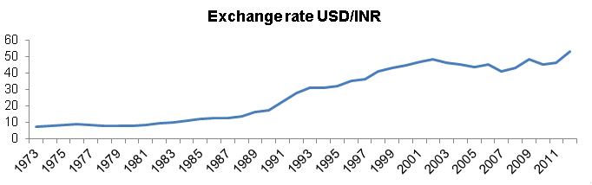
Fall of rupee || Rise of Dollar

Slide 13
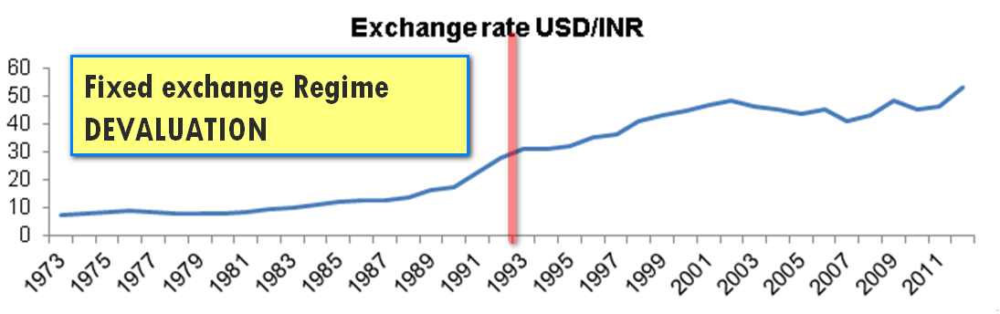
Devaluation vs Depreciation

Slide 14
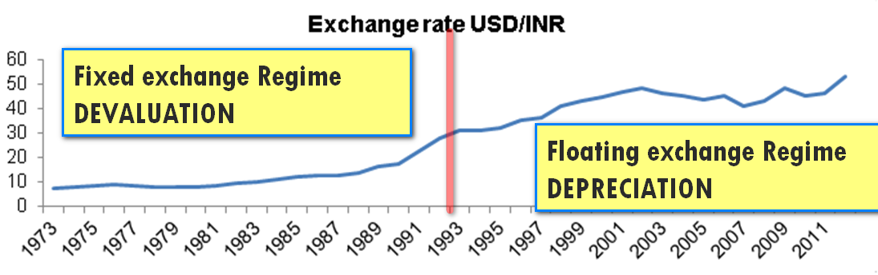
Devaluation vs Depreciation

Slide 15
Rupee: Devaluation || Depreciation
 | Fixed | Floating
1$ = 10; 1$ = 50 | Devaluation | Deprecation

Slide 16
Rupee: Devaluation || Depreciation
 | Fixed | Floating
1$ = 10; 1$ = 50 | Devaluation | Deprecation
1$ = 50; 1$ = 10 | Revaluation | Appreciation

Slide 17
Floating Exchange rate
RBI doesn’t intervene to control exchange rate
Free market, supply-demand
But then- too much volatility in exchange rate.
Hence real-life: “Managed floating”

Slide 18


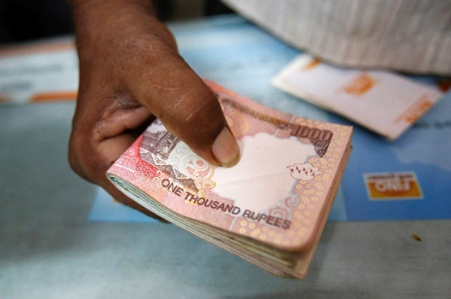

“Managed” Floating exchange rate
I interfere to prevent volatility
Sudden purchase of Rs.
$1=50
$1=40
Not good for exports

Slide 19

“Managed” Floating exchange rate
I interfere to prevent volatility
Equilibrium
Reset
To
$1 = Rs.50

Slide 20



“managed” Floating exchange rate
I interfere to prevent volatility
Sudden purchase of $$
$1=50
$1=60
Not good for imports

Slide 21
Find correct statement
To stop appreciation of rupee, RBI should sell dollars from its forex reserve.
To stop depreciation of rupee, RBI should purchase dollars from market
Both A and B
Neither A nor B

Slide 22
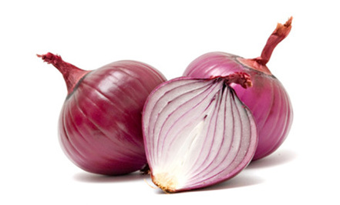
Floating Exchange Rate (Problem of volatility)
Volatility
$1 = 50
$1 = 60
$1 = 65
Sell $$ to stop depreciation
Authorized dealers under FEMA

Slide 23
Floating Exchange Rate (Problem of volatility)
Volatility
$1 = 50
$1 = 60
$1 = 65
Buy $$ to stop
Appreciation
Authorized dealers under FEMA

Slide 24
Find correct statement
To stop appreciation of rupee, RBI should sell dollars from its forex reserve.
To stop depreciation of rupee, RBI should purchase dollars from market
ANSWER
Only 1 correct
Only 2
Both 1 and 2
Neither 1 nor 2

Slide 25
Find incorrect statement
To stop appreciation of rupee, RBI should sell dollars from its forex reserve.
To stop depreciation of rupee, RBI should purchase dollars from market
ANSWER
Only 1 correct
Only 2
Both 1 and 2
Neither 1 nor 2

Slide 26
“managed” floating exchange rate regime
FIXED Exchange Rate
Regime
Floating Exchange Rate
Regime
“Managed” Floating Exchange Regime
(Most countries use this)

Slide 27
NEER and REER
Nominal effective exchange rate
Real effective exchange rate

Slide 28
Nominal vs Real (inflation)
Nominal – Inflation = Real interest rate
Nominal GDP / GDP deflator = Real GDP
Exchange rate: inflation adjust?

Slide 29
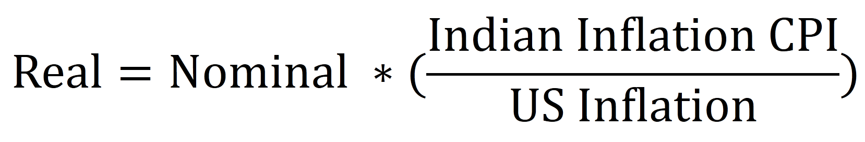
Rs: $ Real exchange rate
6 currencies
Weighed Geometric mean
REER-6
REER-36

Slide 30
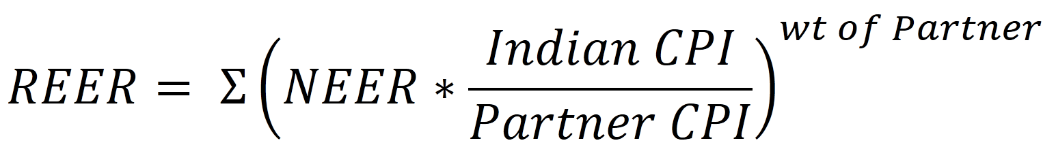
CPI: base 2004, CSO RBI calculates REER, NEER Earlier used WPI

Slide 31
Rupee March 2014 (NEER-6)
NEER
66
REER
112
REER > 100 means overvalued
<100 means undervalued ($1=6 Yuan)

Slide 32

“managed” Floating Exchange Rate
Undervalued yuan good for exports
$1 = 6
$1 = 5
$1 = 4
Buy $$ to stop
Appreciation
Of YUAN
Authorized dealers under FEMA

Slide 33
Assertion reasoning
A: REER is an indictor of trade competitiveness
R: REER is a weighted average of NEER adjusted for price differential between India and its major trade partners
Both right R explains A

Slide 34
Assertion reasoning (Ch6, page 111)
A: To sustain high CAD, country needs net inflow in Capital account
R: In macroeconomics, resource expenditure imbalance in one sector needs to be financed through borrowing from other sectors.
Both right R explains A

Slide 35
BoP: Current vs Capital
CAD, BoP crisis
Exchange rate regime
Fixed
Float
Managed
Rupee devaluation vs. depreciation
NEER- REER

Slide 36
Convertibility
Why convertibility?
Current Account convertibility
Capital Account convertibility

Slide 37
“Managed” Floating Exchange Rate
Volatility
$1 = 50
$1 = 60
$1 = 65
Sell $$ to stop depreciation
Buy $$ to stop
Appreciation
Authorized dealers under FEMA

Slide 38
Why restrictions on convertibility?
Central bank cannot ”manage” floating exchange rate regime all the time
Otherwise Forex-reserve will get empty
Hence quantitative restrictions on rupee-conversion to foreign currency
Two types: based on purpose:
(1) current (2) capital

Slide 39
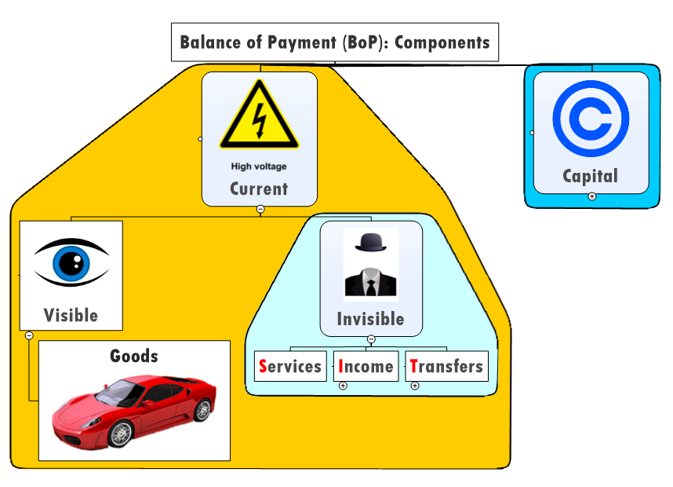
Current account convertibility

Slide 40
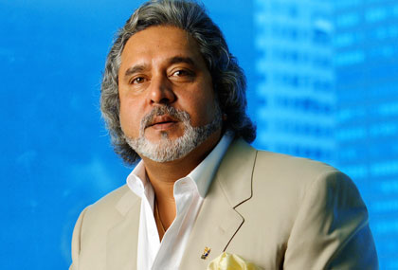


Current account convertibility ($1 = Rs.50)
$1 lakh
$1 Lakh
Rs. 50 Lakh
$1 lakh
CONVERTED
Rupees
to
Dollar$
BoP=> Current Account (Import)
Notes:
SBI takes commission as well.

Slide 41
“FULL” Current account convertibility ($1 = Rs.50)
$3 lakh
Rs. 1.5 Cr
$3 L

Slide 42
Full Current Account Convertibility: Definition
When Rupee is fully convertible into another currency,
for current account transactions.
And vice-versa.

Slide 43
Some Restrictions under FEMA
Not on Betting, gambling, prohibited items
Travel to Nepal, Bhutan: $10k || Rs.100 denomination.
Other: $25k per visit (beyond need RBI permission)
Education, Medical treatment, Employment: 1 lakh$
Gift sending: Rs.5 lakh worth

Slide 44

Floating Exchange Regime
$3 lakh
Rs. 1.5 Cr
$3 L
Indian Rupee is Fully convertible on Current Account

Slide 45
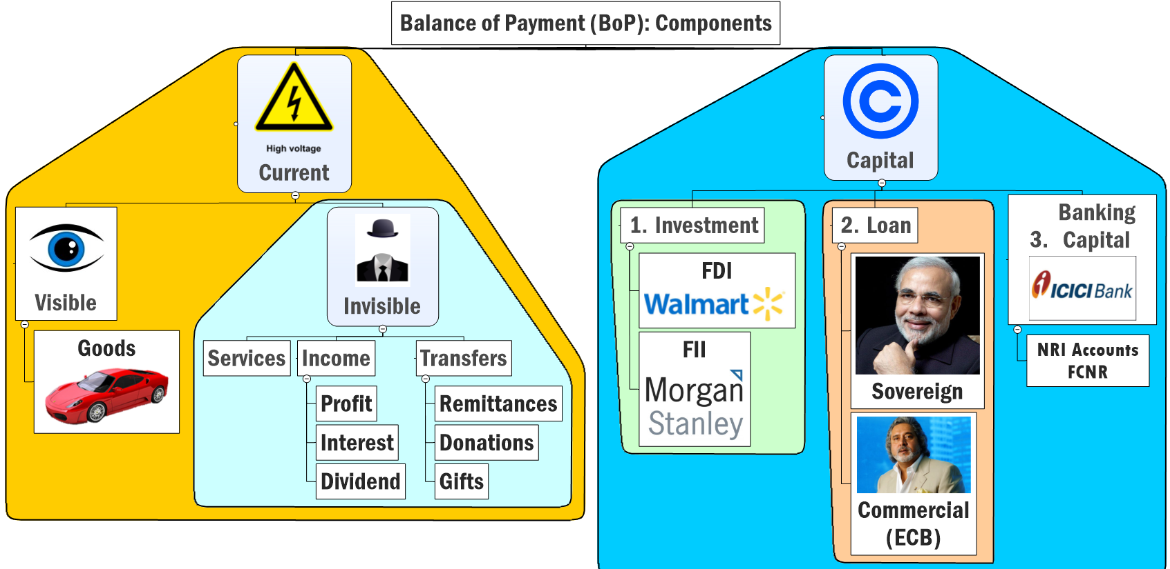
Capital Account Convertibility
??

Slide 46


Capital Account convertibility ($1 = Rs.50)
1 billion$
10%
Rs. 50 Billion
$1 billion
Rs. 50 Billion

Slide 47

Capital account convertibility ($1 = Rs.50)
ECB- FEMA
Quota: 1 Billion$ Entire Aviation sector
Individual company: 300 million$
Maturity: 3 years minimum
+ Approval RBI

Slide 48

Capital Account convertibility ($1 = Rs.50)
1 billion$
10%
Rs. 50 Billion
$1 billion
Rs. 50 Billion
Indian Rupee is not Fully convertible on Capital Account

Slide 49
Capital Account Convertibility (FEMA)
FDI, FII restrictions
100% for Investment in Bhutan
Everywhere else: max. $75k per year (individuals). e.g. buying shares, opening foreign bank accounts
Financial Action Task Force (FATF): “Non co-operative countries" [Iran, N.Korea]

Slide 50
Liberalized remittance scheme (2004)
“Indian residents”
Spend $2.5 lakh dollars per year per person abroad
Rs.60=$1
Rs.1.5 crore=>$2.5 lakh=> spend abroad

Slide 51
Liberalized remittance scheme (2004)
FEMA | Current | Capital
Medical | $1 lakh | --
Share purchase | -- | $75,000
+ $2.5 lakh under LRS
Both Current + capital account combined
In addition to FEMA

Slide 52
To stop weakening
Of Rupee
$1=70Rs.
After stability, LRS easy
$1.25 lakh (2014, June)
$2.5 lakh (2015, Feb)
Stop $$ outflow
FEMA tight
LRS Tight: $75,000 (2013)

Slide 53
Definition: Convertibility
Current Account C. | Capital Account C.
When Rupee is fully convertible into another currency, for CURRENT account transactions. And vice-versa. | When Rupee is fully convertible into another currency, for CAPITAL account transactions. And vice-versa.
Full | Partial

Slide 54
Rupee: Capital Account Convertability
Liberalization
Fully convertible
(100%)
*Not* Fully convertible
(40%)

Slide 55
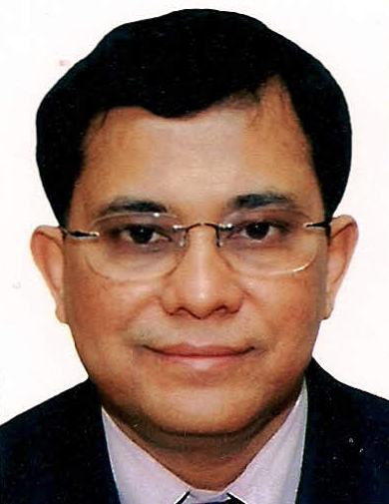
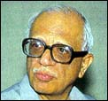
FAVOR (Tarapore)
AGAINST (HR Khan)
Easier FDI, FII, ECB => Biz.expansion => new jobs, economic growth.
IMF study did not find such correlation.
Notes:
hoarding

Slide 56
Favor
Against
CAL=> inflation declines
Indian inflation = supply side bottlenecks + political instability
CAP.LIB. Can’t fix

Slide 57
IF FULL Capital Account convertibility
1 billion$
10%
Rs. 50 Billion
Rs. 1 Billion Profit per year
Inflation? Less passengers
War? $1 = Rs.70
ATF tax increased?
Notes:
Risk to entire system

Slide 58
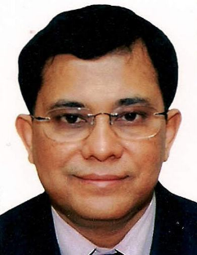
FAVOR
AGAINST
ECB: Rupee cash flow vs Dollar repayment
Exchange Rate volatility=>collapse. BoP crisis
Large forex reserve couldn’t prevent such crisis in Malaysia and Thailand (late 90s)

Slide 59
Before Asian Crisis 1997
East Asian Economies
Deliberately kept currencies undervalued (too boost exports)
Forex reserve…very high (undervalued)
Full capital account convertibility
Foreign investment ….high
GDP growth….double digit
Per capita income…very high

Slide 60
During Asian Crisis 1997
Thailand’s steel and automaker companies filed bankruptcies
Foreign Investors pulled out dollar$$ from similar companies from all East Asian nations
$1 = 2000 Indonesian Rupiah
$1= 18,000 Indonesian Rupiah
High inflation, Rioting, political instability
Central banks’ their forex reserves depleted in stabilize exchange rate volatility => BoP Crisis.

Slide 61
GDP growth rate (1998)
Full / very liberal capital account convertibility
Partial capital account convertibility

Slide 62
Capital Account Liberalization (CAL)
FAVOR
AGAINST
India, China did not face crisis because they didn’t have full capital account convertibility
Don’t need large FII, FDI, ECB, just make people invest in bank/securities instead of gold/real-estate.

Slide 63
Mock MCQ (1996)
full capital account convertibility of Indian rupee is being advocated because:
It’ll stabilize rupee’s exchange value against major currencies of the world
it will help to promote exports
it will help India secure loans from the world financial markets at attractive terms
it will attract more foreign capital inflow in India.

Slide 64
Mock MCQ (1996)
full capital account convertibility of Indian rupee is being advocated because:
It’ll stabilize rupee exchange value against major currencies of the world (NOT Necessary. E.g. War, QE, FT)
it will help to promote exports (CURRENT)
it will help India secure loans from the world financial markets at attractive terms. (NOT Necessary)
it will attract more foreign capital inflow in India.

Slide 65
Capital Account Convertibility

Slide 66
S.S. Tarapore (1997)
C.Convert
Dy. Gov RBI
In Three phases [98, 99, 00]
Preconditions
Fiscal deficit: 3.5% of GDP (2000)
Inflation avg 3-5% (three years)
Interest rates decontrol
Enough forex to sustain 6 months’ import
NPA 5% of their assets
CRR: 3%
Finally: Full capital account Convertibility

Slide 67
Tarapore: 97: full. But time not ripe
Preconditions | 2013-14
Fiscal deficit: 3.5% of GDP | >4 %
Inflation avg 3-5% (three years) | double digit
Interest rates decontrol | Not for agro.
Enough forex to sustain 6 months’ import | Yes
NPA 5% of their assets | ~6%
CRR: 3% | 4%

